Slide 1

AUTOCORRECTOR FEATURE USING NLP
JNTUH UNIVERSITY COLLEGE OF ENGINEERNG JAGTIAL
DEPARTMENT OF CSE
BATCH NO:15
1.KASAGONI JAGRUTHI-20JJ1A0522
2.BAIRI SRIKRISHNA-20JJ1A0508
3.KOLAPUDI KAVITHA-20JJ1A0523
4.MULKALA ANUSHA-20JJ1A0533
Date of presentation:-23-11-2023
PROJECT GUIDE:
P.SREENIVASA RAO
ASSOCIATE PROFESSOR OF CSE

Slide 2
CONTENTS
Introduction
Existing system
Proposed system
System Architecture
Methodology
Technologies used
Results
Advantages
Conclusion
References

Slide 3
INTRODUCTION
In the era of rapid digital communication, where even a small typo can alter the meaning of a message, our project takes on the challenge of perfecting written content. Introducing an auto-correct system designed to seamlessly address common spelling errors and enhance the overall accuracy of text.

Slide 4
EXISTING SYSTEM
In the current digital communication landscape, existing auto-correct systems fall short in providing a seamless solution to common spelling errors. These systems often struggle with accuracy, user interaction, adaptability, and scalability.
DISADVANTAGES:
Inaccuracy:
Current systems may not always accurately identify and correct spelling errors, leading to potential misunderstandings in communication.
Static Correction Methods:
Some systems rely on basic correction methods and may struggle with nuanced errors or variations in spelling.

Slide 5
PROPOSED SYSTEM
The system utilizes a modular architecture, encompassing components such as filtering misspells, a sophisticated word suggestion mechanism, probability distribution, and advanced correction techniques using N-grams and minimum edit distance.
Improved Accuracy:
Utilizes a four-component architecture, incorporating advanced techniques for precise corrections.
User-Friendly Interface:
Integration of a Tkinter-based interface for a smooth and interactive user experience.

Slide 6
System Architecture
Input sentence
Filter Misspells
Word Sugggestion
Mechanism
Probability
Distribution
Mechanism
Replace Misspells
Output
Sentence

Slide 7
METHODOLOGY
Data Collection
Data Preprocessing
Filtering Misspells
Word Suggestion
Probability Distribution
Replace Misspells
N grams
Minimum Edit Distance
User Interface Implementation

Slide 8
TECHNOLOGIES USED
Programming languages used:
Python
User Interface:
Tkinter
Algorithms used:
Probability Distribution
N-grams
Minimum edit distance
Libraries used:
NLTK
pandas, numpy
Collections

Slide 9
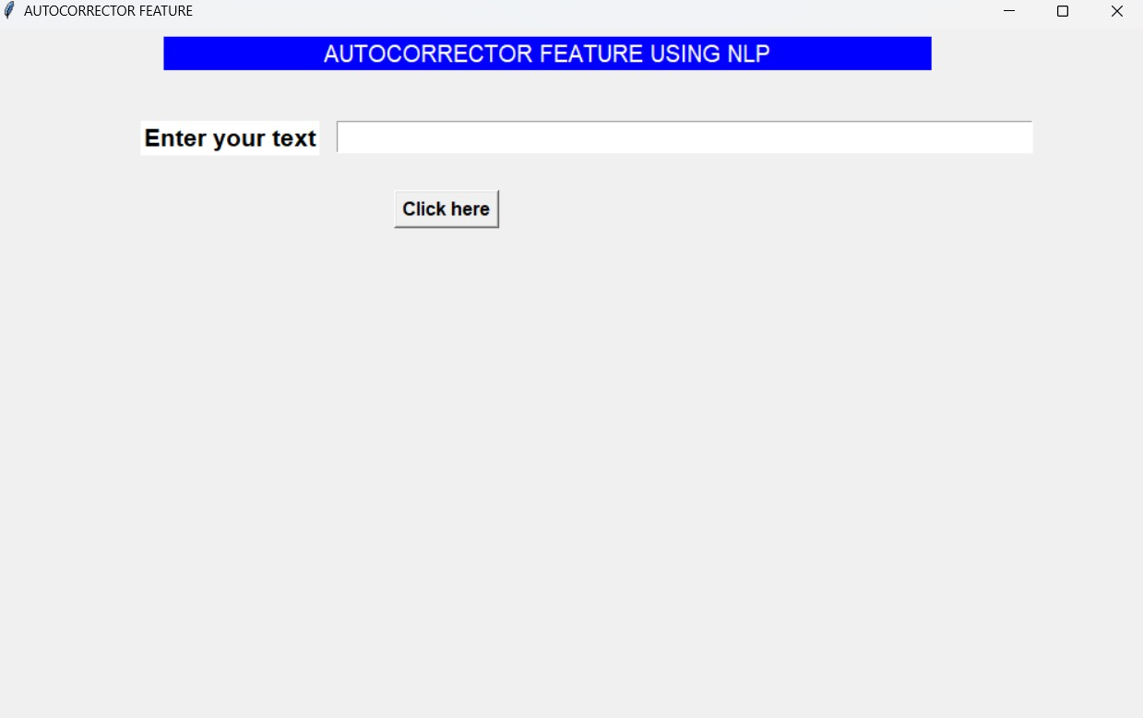
RESULTS

Slide 10
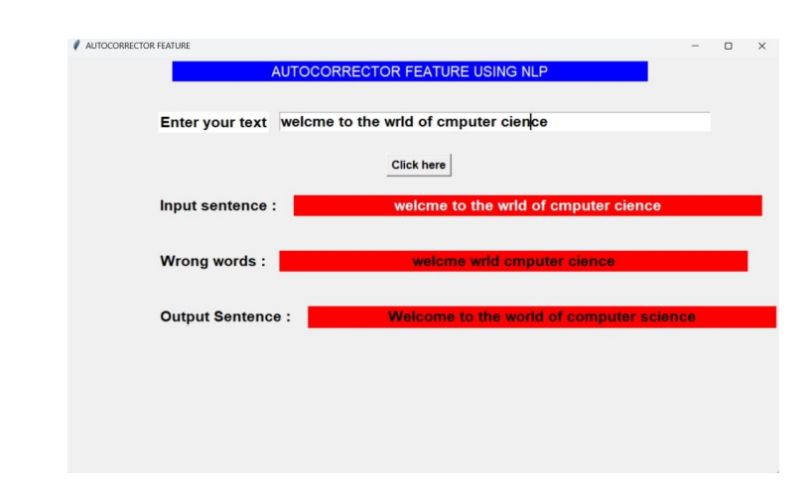
RESULTS

Slide 11
ADVANTAGES
Enhanced Writing Accuracy
Time Efficiency
Language Learning Support
Consistent Corrections

Slide 12
CONCLUSION:
Our project is like a smart friend that helps you write better. It's like having a helpful buddy making your writing clear and crisp.
The words are suggested to end user is based on three algorithms Ngrams and Minimum Edit Distance, Probability distribution.
The algorithms filter out the dictionary words and provide the exact suggestion to the user,
So that user entered text can be error free and does not contain any spelling mistakes.

Slide 13
REFERENCES
Natural Language Processing with Python -- Written by Steven Bird, Ewan Klein, and Edward Loper
Speech and Language Processing-- Written by Daniel Jurafsky and James H. Martin
Online website – DeepLearning.AI, Freecodecamp.

Slide 14
THANKYOU

